Slide 1
The Internet
Clients, Servers, Routers, Networks
Broadband, Wireless & Dial up
Connecting backbone
The roles of points of presence & network access points
By Jack Stewart, Rhys Harris, Mathew Clark and Jordan Wensley

Slide 2
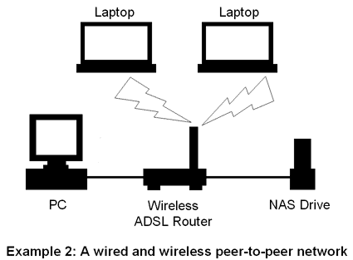

Slide 3
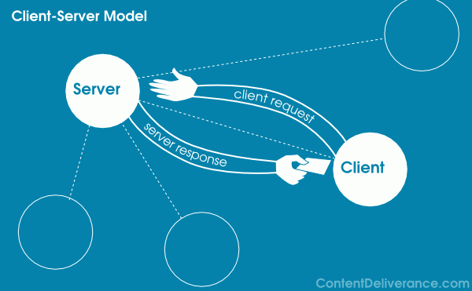
Clients
A client is a computer program that, as part of its operation has to send a request to another computing programs.
A client is a piece of computing hardware or software that accesses a service made available by a sever.
A client accesses the service by way of a network.

Slide 4
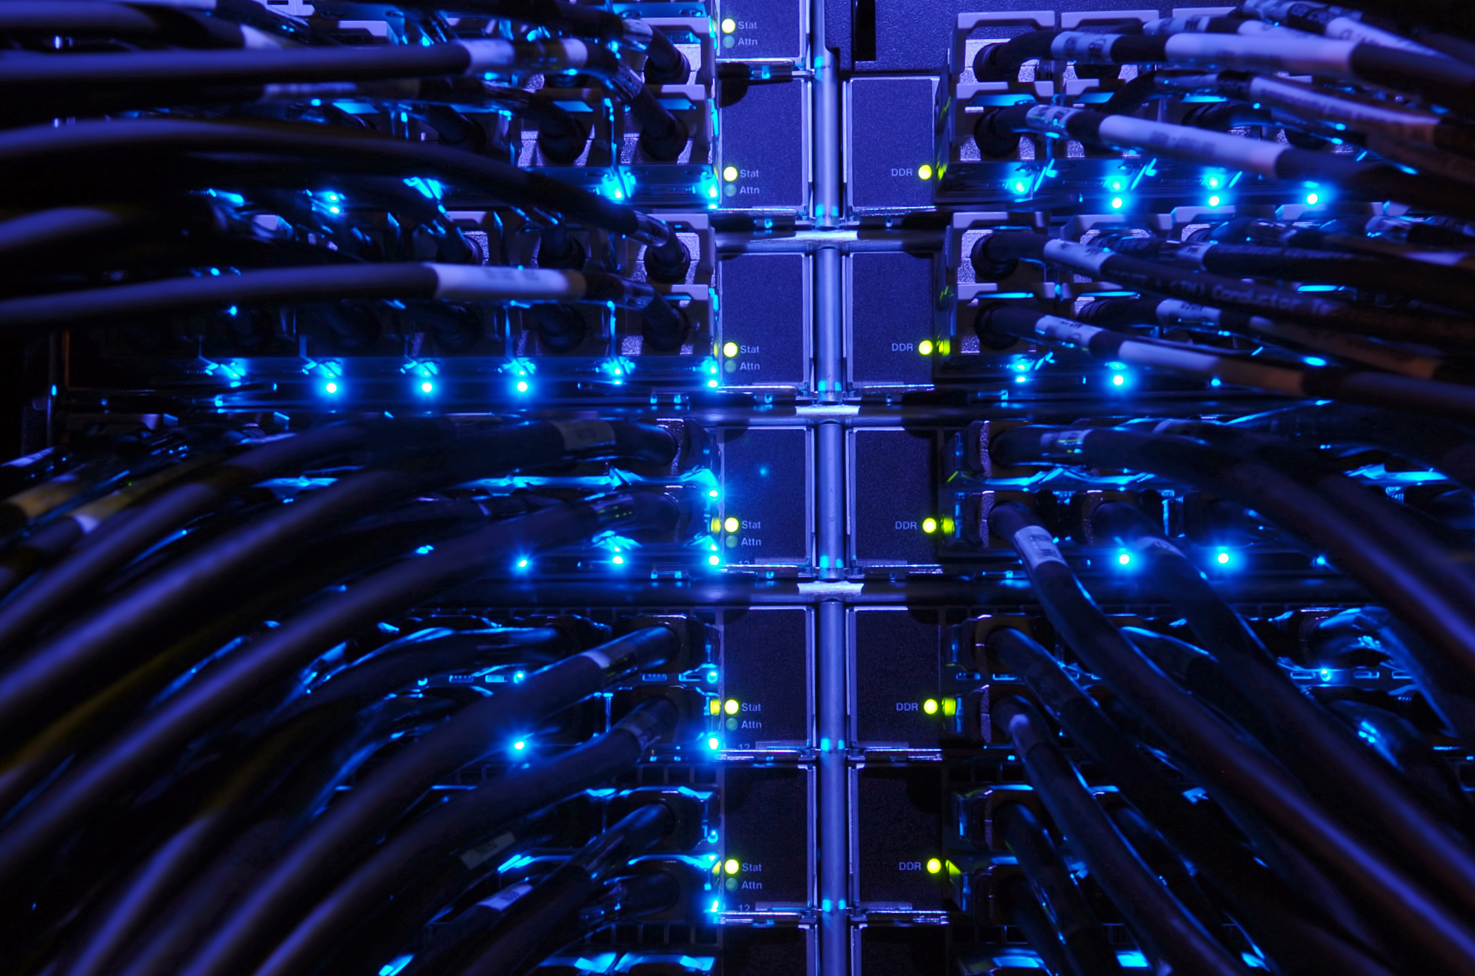
Servers
A server is a system software and a computing hardware that responds to requests across a computer network to provide or help to provide a network services.
There are many different types of servers for example web servers, game servers, mail servers and printing servers.

Slide 5
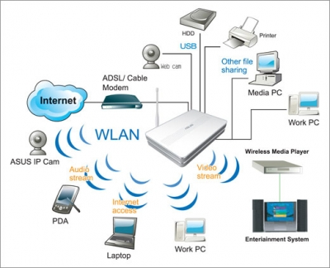
Routers
A router is a device that forwards data packets between computer networks, creating an overlay internetwork. A router is connected to two or more data lines from different networks.
The most common type of routers are home and small office routers that simply pass data, like a web pages, email, IM (instant message) and videos between the home computers and the Internet.
The most powerful core routers can forward data at high speed along the optical fibre lines of the Internet.

Slide 6
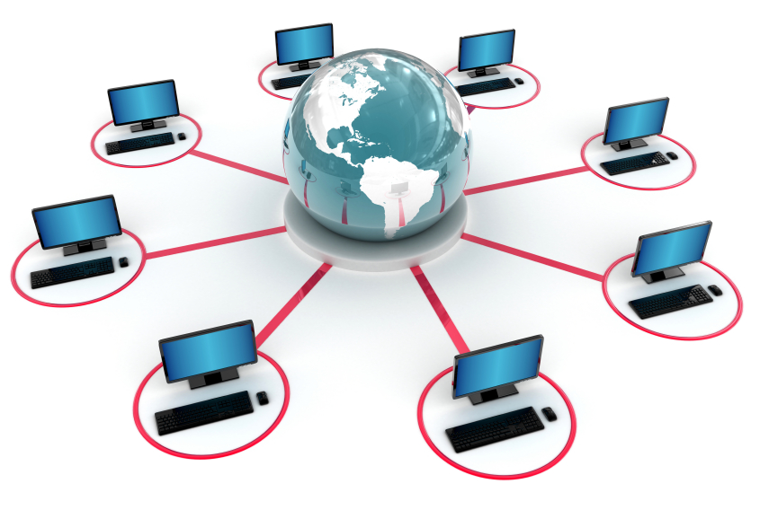
Networks
A computer network or data network is a network that allows computers to exchange data.
Computer networking may be considered a branch of electrical engineering, telecommunications, computer science, information technology or computer engineering.

Slide 7
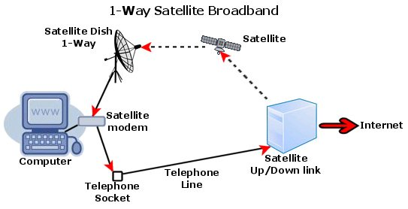
Broadband
The term broadband refers to the wide bandwidth of a transmission and its ability to transport multiple signals and traffic types simultaneously. Coax, optical fibre, twisted pair & wireless are all different methods of using broadband.

Slide 8
Broadband
Advantages
-High speed "always on" connection
-Fixed monthly cost
-Phone line is separate
-Faster for surfing & downloading, up to x10 faster
-Ability to work from home
-Value for money
Disadvantages
-Not available to everybody
-Variable speeds depending upon time of day

Slide 9
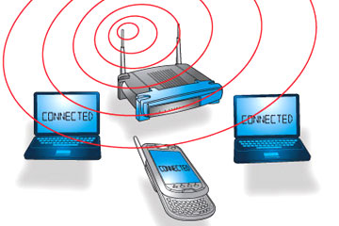
Wireless
Wi-Fi creates a network in your home or office (a little zone where computers can get broadband internet). It uses radio waves just like TV or mobile phones. You may sometimes hear people call this zone “WLAN” (Wireless Local Area Network).

Slide 10
Wireless
Advantages:
-No wires!
-Mobility
-Can use lots of laptops/comps at the same time with a router.
Disadvantages:
-Can be unpredictable
-Your neighbour could steal your internet off you by sharing it, and therefore slowing your connection down.

Slide 11
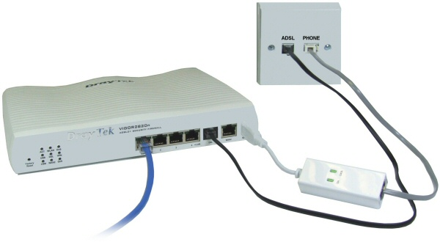
Dial up
Dial-up Internet access is a form of Internet access that uses a public switched telephone network to a establish a dialed connection to an Internet service provider via telephone lines. The user's computer or router uses an attached modem to encode and decode Internet Protocol packets and control information into and from analogue audio frequency signals.

Slide 12
Dial up
Advantages:
-Low Cost
-New IP is created when a user logs in (Almost impossible to hack)
-Availability
Disadvantage:
-Lags Behind in Speed
-Unstable Dial-up Connection
-Demands a Phone Line

Slide 13
Connecting Backbone

Slide 14
What actually is it?
The Internet backbone refers to the principal data routes between large, strategically interconnected networks and core routers on the Internet (Sky, Virgin). These data routes are hosted by commercial, government, academic and other high-capacity network centres (Cloud computing), the Internet exchange points and network access points, that interchange Internet traffic between the countries, continents and across the oceans of the world.

Slide 15
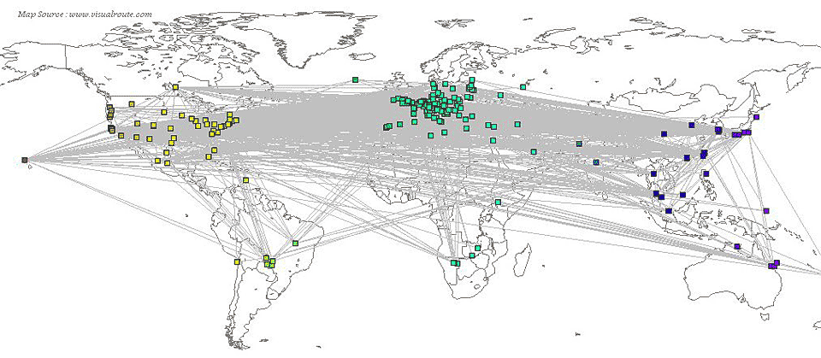
Backbones
Backbones which connect across the world

Slide 16
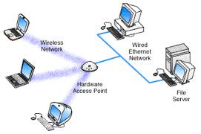
WHAT IS A NETWORK ACSSES POINT
A Network Access Point was a public network exchange facility where Internet service providers connected with one another in peering arrangements. The NAPs were a key component in the transition from the 1990s NSFNET era to the commercial Internet providers of today.

Slide 17
THE ROLES OF POINTS OF PRESENCE
An Internet point of presence is an access point to the Internet. It is a physical location that houses servers, routers, ATM switches and digital/analog call aggregators. It may be either part of the facilities of a telecommunications provider that the Internet service provider (ISP) rents or a location separate from the telecommunications provider. ISPs typically have multiple Pops, sometimes numbering in the thousands. Pops are also located at Internet exchange points and colocation centres

Slide 18
Advantages for (NAP)
The advantage is that this (NAP) is that is it can connect to anywhere across the world by phone and computer.

Slide 19
Advantages of a (pops)
An Internet point of presence is an access point to the Internet. It is a physical location that houses servers, routers, ATM switches and digital/analog call aggregators. It may be either part of the facilities of a telecommunications provider that the Internet service provider (ISP) rents or a location separate from the telecommunications provider. ISPs typically have multiple Pops, sometimes numbering in

Slide 20
The end

